Slide 1
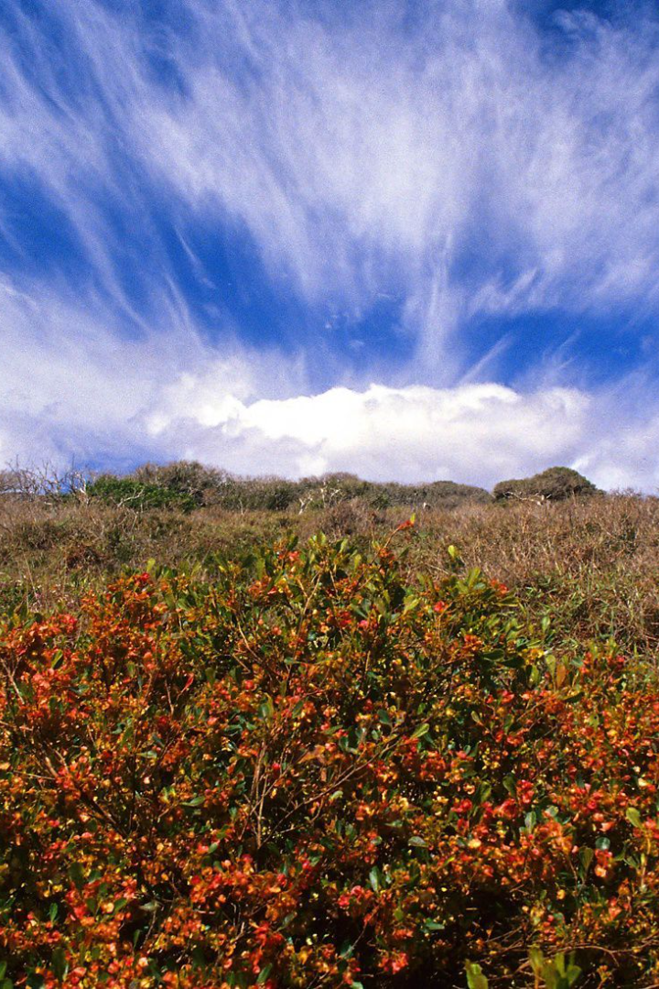
Exploring the Diverse World of Dryland Forest Cover Dynamics in Zimbabwe
With AI-driven insights and technical advancements, our research project aims to investigate the dryland forest cover dynamics in Lupane, Zimbabwe, with an emphasis on conservation, preservation, and management strategies.
BK
by Bukhosi Khumalo

Slide 2

Objectives of the Study: A Sustainable Future for Zimbabwe’s Dryland Forests
1
Identify
2
Analyze
3
Develop
The current status and distribution of Lupane’s dryland forests
The drivers of deforestation and the impact of forest cover change on local communities and the environment
A machine learning-based model to predict future forest cover change and provide recommendations for sustainable management policies

Slide 3
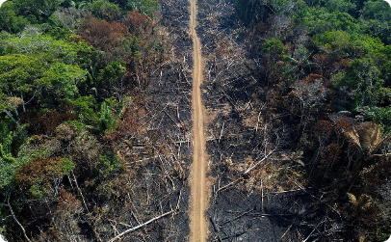


Literature Review: A Glimpse at Past and Ongoing Forest Cover Research
History of Deforestation in Zimbabwe
Current Policy Recommendations
Dryland Forest Ecology and Dynamics
Zimbabwe has suffered a significant loss of forest cover by natural and anthropogenic events. We will investigate the causes and possible solutions.
We will review existing forestry policy documents in Zimbabwe and explore how our findings can contribute to the country's plans for sustainable forest management.
Existing scientific reports on dryland forests indicate that they could be more resilient to disturbances than previously thought. We will examine these findings and explore their implications.

Slide 4

Methodology: Right Tools for Right Results
Data Preprocessing
The collected data will be cleaned, harmonized, and prepared for the model through machine learning processing, data augmentation, and feature engineering.
1
2
3
Field Data Collection
Model Development
Two sets of fieldwork will be carried out to collect tree measurements, socioeconomic information, and imagery data.
We will develop a machine learning model to forecast future forest cover changes in Lupane. The model will consider environmental and socioeconomic variables to estimate the probability of change.

Slide 5
Expected Outcomes and Significance of the Study: A Proactive Approach to Dryland Forest Conservation
Data-Driven Forest Policies
Capacity Building
The model will generate data-driven recommendations for enhancing forest cover, carbon sequestration, and community livelihoods.
The project will provide capacity building and technical training to relevant stakeholders, including community members and policymakers.
Sustainable Resource Use
Contribution to Global Conservation Efforts
Our study aims to promote sustainable use of forest resources in Lupane and enable communities to benefit from them.
The study will contribute to global dryland forest conservation efforts and inform policymakers and practitioners worldwide.

Slide 6
Limitations and Challenges: Overcoming the Hurdles
1
Data Availability
We face a challenge in collecting reliable data on dryland forests in Lupane due to remote locations and logistical constraints.
Technical Challenges
2
The machine learning model development process can be complicated and resource-intensive, and requires technical expertise and capacity building.
3
Community Involvement
Effectively involving local communities in the project and achieving social and environmental justice will be challenging but necessary.

Slide 7

Conclusion and Future Directions: Bridging the Gap
Our project has immense potential for the conservation and restoration of Zimbabwe's dryland forests, which provide crucial ecosystem services and local livelihoods. Through collaborations with policymakers, local communities, and other stakeholders, we aim to bridge the gap between science and action, promote sustainable forest management, and foster a sustainable future for Zimbabwe and the world.

